Slide 1
The Csound Utilities
Csound provides a number of utilities that can either be executed as stand-alone programs or invoked via the command line option -U
A number of Csound’s most interesting unit generators require data generated by one of these utilities
In most cases, the utilities operate on standard (integer) audio files (WAV or AIFF)
Some utilities require the user to set critical parameters (such as analysis window size, hop size, etc) that directly affect the results (see the Csound manual)

Slide 2
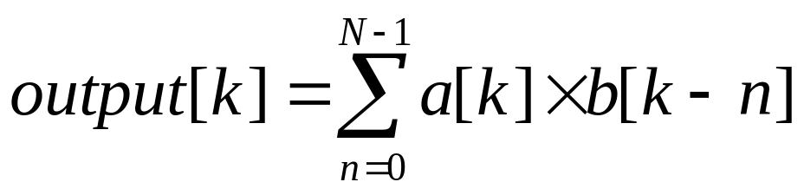
Convolution in Csound
Convolution: a process of combining two digital signals by multiplying every sample of one signal (called the Excitation, or Input Signal) by every sample of another signal (called the Impulse Response) and summing the results
Where N is the length of signal a and k ranges over entire length of b [Roads, p. 422]

Slide 3
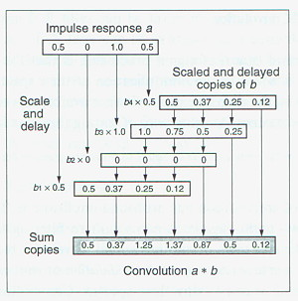
Multiply, Add, and Slide

Slide 4
Simple Examples
If the Impulse Response b is [1, 0, 0, 0, …] (called the unit impulse), then convolving it with any arbitrary Excitation Signal a results in a single, unmodified copy of a
FIR filtering is, in fact, convolution:
Where the coefficients [a,b,c…] are the IR, and x[n] is the Excitation Signal

Slide 5
Applications of Convolution
Filtering (see previous slide)
Reverberation: an input signal is convolved with the impulse response of a room
Cross-Synthesis: two arbitrary signals are convolved (doesn’t matter which is IR); the result is a combination of the amplitude and spectral characteristics of both signals

Slide 6
“Direct” versus “Fast” Convolution
Direct convolution is extremely expensive, computationally: on the order of N² multiplications (N is length of longest signal)
Use Csound dconv opcode for this (Moss)
“Fast” convolution takes advantage of the fact that convolution in the time domain is equivalent to multiplication in the frequency domain.
FFTs are performed on both input signals, then spectra are multiplied, then IFT applied to result.

Slide 7
convolve and –U cvanal
The Csound convolve opcode implements “fast convolution”
First use cvanal on one signal, usually the shortest, called the Impulse Response.
Output file is an FFT of the IR, typically (but not necessarily) named convolve.nnn
The convolve opcode internally performs an FFT on the other signal, then multiplies their spectra, then performs an Inverse Fourier Transform on the product

Slide 8
Syntax of convolve
ar1[, ar2[, ar3[, ar4]]] convolve ain, ifilcod, ichannel
ain = input (excitation) signal
ifilcod = convolve.# or “filename”
ichannel = optional channel specifier
Note: output will be delayed by length of impulse file
Delay the input “dry” signal by this amount if you wish to align it with the “wet” signal from convolve

Slide 9
Syntax of cvanal
CSound -U cvanal [flags] infilename outfilename
infilename – impulse file to be analyzed
outfilename – output file name (usually convolve.nnn)
Flags:
-s rate – sampling rate of the audio input file.
-c channel – channel number sought. Default is all channels.
-b begin – beginning time (in seconds). Default is 0.0
-d duration – duration (in seconds). Default is to the end of the file.

Slide 10
Reading
Boulanger: Chapter 26 (Spjut), pp. 507-515
Roads: pp. 419-432
Csound manual: cvanal, convolve

